Slide 1
Bibliodiversity
Consuelo Rivera-Fuentes
The Publishing Profession (7PU500)

Slide 2
The Forty-two-line Bible
Most of the components of printing were known in Europe by the fifteenth century. Paper had been introduced from the East around 1200. Presses were used in making wine and olive oil. Block printing —utilising a piece of wood with words and pictures carved out of it——was employed for making playing cards and religious posters.
The key invention in printing was movable type: individual letters that could be reassem­bled and used over and over again. Movable type was in­vented, probably by Johannes Gutenberg some time in the early fifteenth century. Gutenberg lived most of his life in Mainz, Germany. He produced a Bible in 1448 and a missal be­tween 1448 and 1452. His greatest achieve­ment was the so-called forty-two-line Bible, or Gutenberg Bible, printed between 1450 and 1455.
http://cosworldhistory.pbworks.com/w/page/9468599/Lesson%202-01%20-%20The%20Printing%20Press

Slide 3
What is bibliodiversity?
Bibliodiversidad : a term coined in the 1990s by a group of Chilean independent publishers and has since been adopted by the International Alliance of Independent Publishers (Schiffrin, 2001; Pouliquen and Testard, 2010; Hawthorne, 2014).
Bibliodiversity is a complex self-sustaining system of storytelling, writing, publishing and other kinds of production of oral and written literature.
The writers and producers are comparable to the inhabitants of an ecosystem. Bibliodiversity contributes to a thriving life of culture and a healthy eco-social system. While large publishers do contribute something to publishing diversity, through the quantitative importance of their production, it is not enough to guarantee bibliodiversity, which is not only measured through the number of titles available.

Slide 4
Independent Publishers
Small Press’, ‘Indie Publishing’, ‘Independent publisher’ are terms very often used interchangeably but this can be misleading because there are independent publishers who are ‘small’ or ‘indie’ (in the sense of self-publishing).
Independent publishers do not depend on funds or support, ‘financial or in-kind, from institutions such as political parties, religious organisations or universities, that gives them rights to make decisions on publishing’ (International Alliance of Independent Publishers, 2014). This does not mean publishers cannot apply for and accept grants, but the decision-making processes stay with the publishers and not with the granting authority

Slide 5
Bibliodiversity 2
Bibliodiversity: production of local and marginal knowledges outside the mainstream. Producers of bibliodiversity inhabit the margins: Socially, politically, geographically and linguistically (Hawthorne, 2014)
It is supported by: Biodiversity and Multiversity
Bibliodiversity
Biodiversity
Multiversity

Slide 6
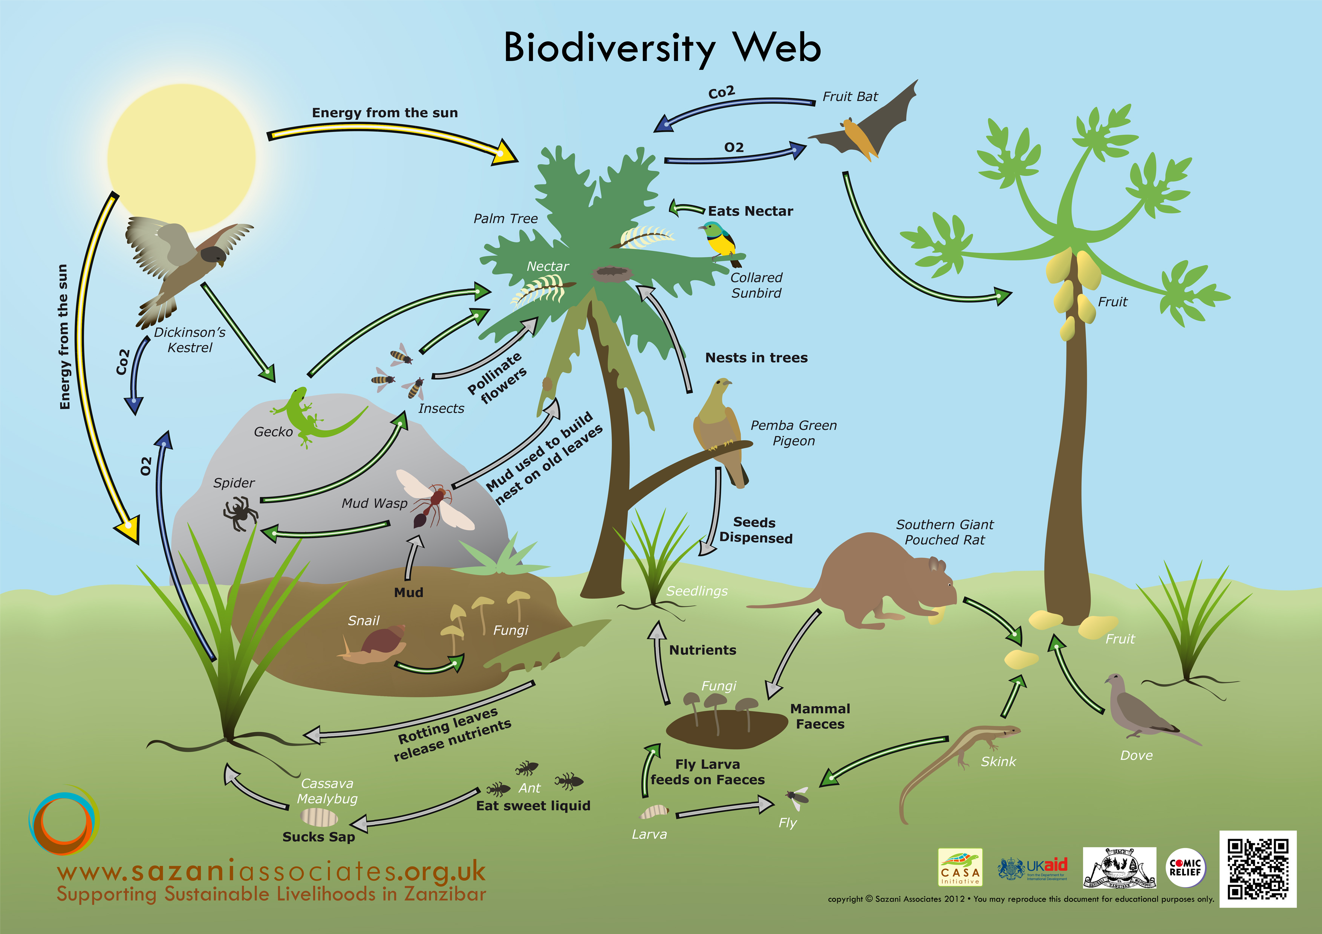
Biodiversity
It is an ecosystem of productivity where each species has an important role to play. For example, ‘a larger number of plant species means a greater variety of crops. Greater species diversity ensures natural sustainability for all life forms’ (Global Issues, 2014). Healthy eco-systems have a high level of diversity

Slide 7
Multiversity
Resistance to western structured knowledge. Respect for systems of knowledge which include experience as well as study (Wangoola, 2000; Hawthorne, 2002 and 2014)
Epistemological Knowledges born out of study and research
Ontological Knowledges born out of experiences (individual and collective)

Slide 8
Bibliodiversity: a view from below

Slide 9
Bibliodiversity Summary
Biodiversity
Bibliodiversity
Multiversity

Slide 10
Sausan Hawthorne’s Conclusion

Slide 11
My Conclusion
Global, mega publishing will not stop their standardised production of money-making works of fiction, non-fiction and sometimes poetry. For that to happen, capitalism, militarism, and market-driven economies would have to disappear. Publishing is full of generalisations, but a lot of the larger houses would not commission a book if they did not think they could sell at least 15,000 copies of it. This does not mean that big publishers reject individuality; that is one of the reasons why some major publishing groups still retain or create individual imprints. Similarly, small, truly independent publishers will continue to exist as long as they are not assimilated into the world of money-grabbing, sameness and uniformity. Moreover, if they are able to co-exist alongside major publishers collaborating or influencing in the creation of a multiverse and ecological bibliodiversity, then the publishing industry might reach a healthy, dynamic balance. There are many challenges small independent publishers face, for example, the move to digital publishing, but if they truly believe in organic publishing and bibliodiversity, change must be embraced and diversity must be encouraged.

